Slide 1
PowerBI Tips and Tricks: Marketing Performance Hub
Marketing Operations: Feedback Analytics and Insights Pillar
Srujana Pavuluri

Slide 2
Agenda
Welcome
Overview - Executive
Genral Tips
Self Service Training
Q&A
Reporting Champions

Slide 3

Marketing Operations Open Office Hours
Get your questions answered by the marketing operations team. Open Office Hours are held monthly with the following agenda:
  Learn about a tip or best practice
  Ask a question – Pre-submit your questions here or ask during the office hours
  Learn how to leverage IQVIA’s marketing systems and processes most effectively
Action: Sign up here, if you need to be added to the outlook invite
Reminder: Save your questions for the end or enter in the chat. We will address as many as we can!

Slide 4
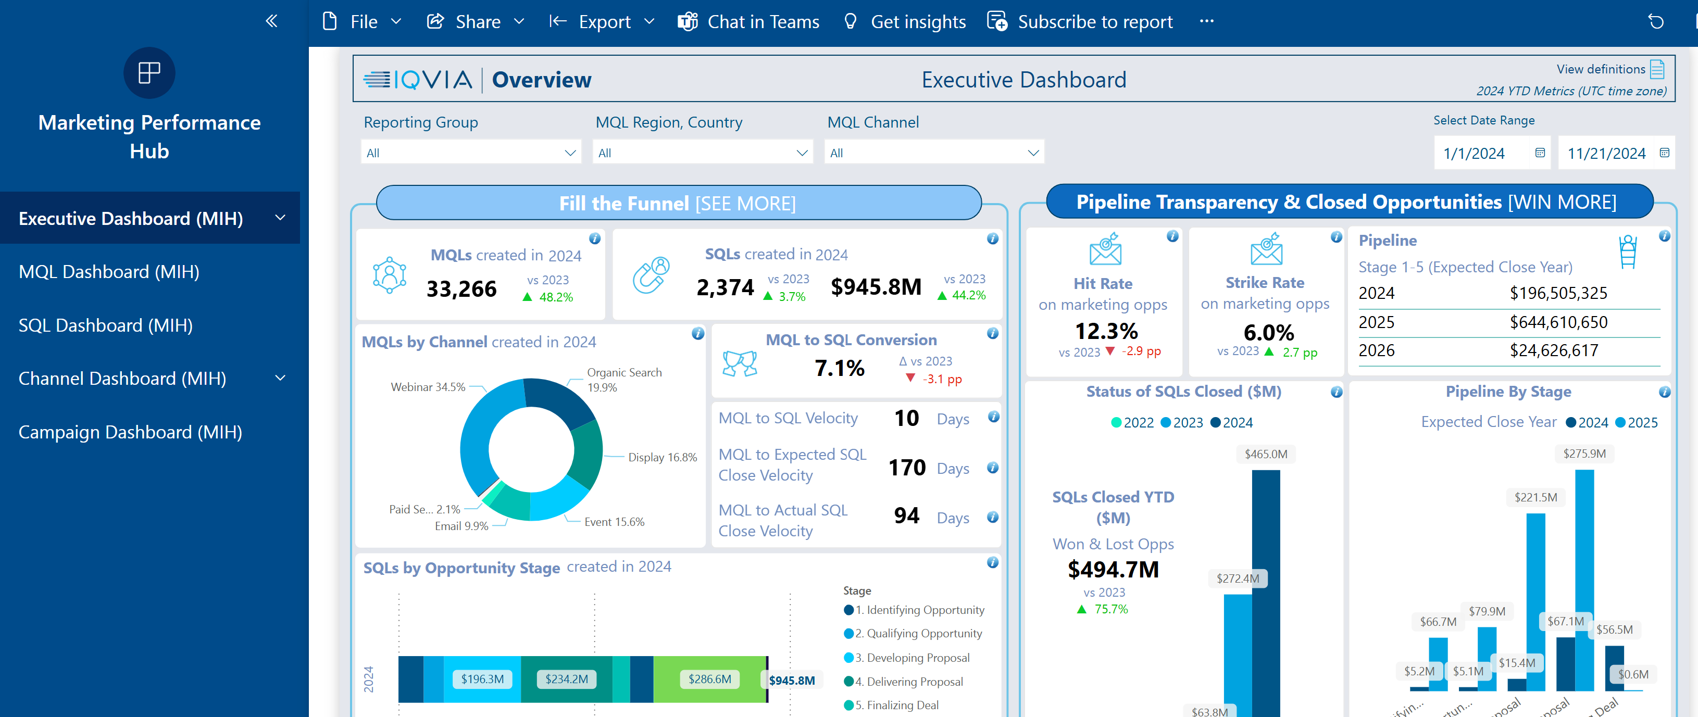
Overview of Power Bi environment and tool
  Refresh: Data is refreshed twice a day at 5am EST and 8pm EST
  Information: Tooltips can be found for almost every metric and module, just hover over the i
  Filters:
    Filters stay applied even if you leave the page and return
    Best practice is to reset filters each session to ensure accurate comparisons
  Comparison: All comparison metrics are Year over Year comparisons looking at the same time frame
  Bookmark: Bookmarks save frequently used filter view for quick, consistent access
  Drill through: Right click on metrics for drill through to dive deeper into specific data points.
  Match: Many reasons data won’t match other sources exactly like archived MQLs are included, refresh schedule differs from others, different date filter used etc.
Leverage Your Reporting Champion

Slide 5
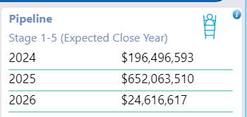
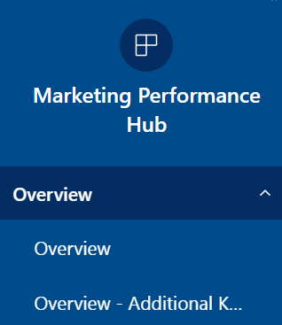
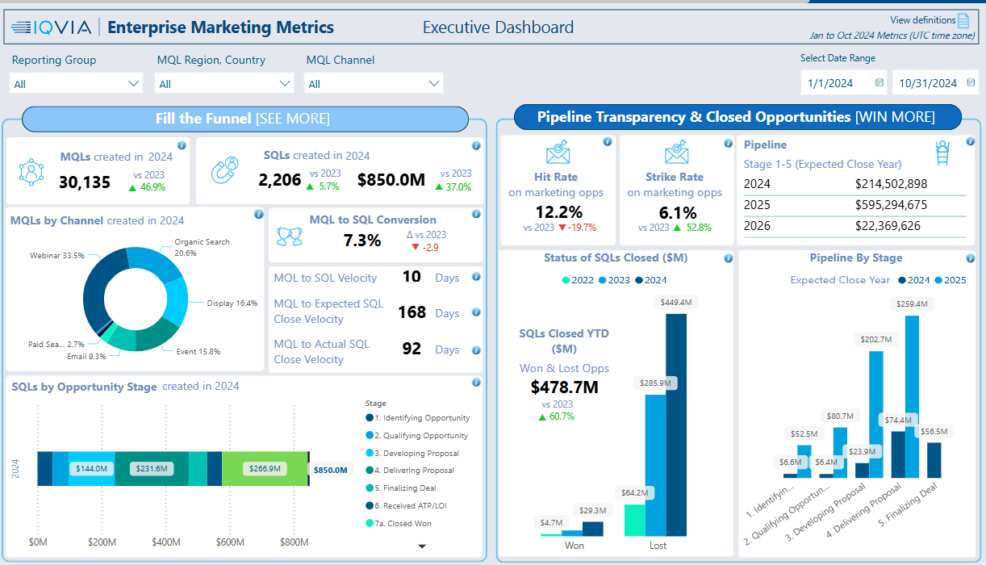
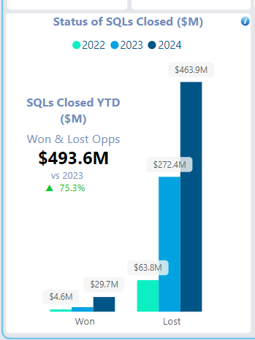
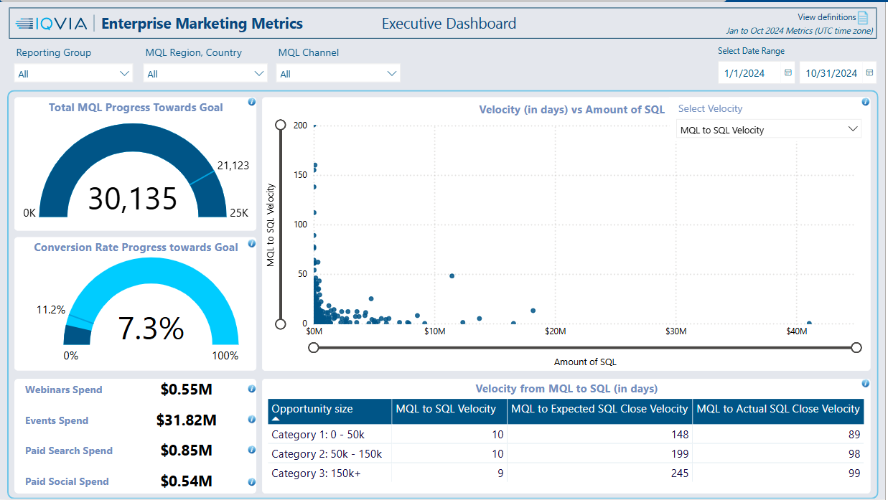

Overview
Pipeline
Opportunities that are tagged with an Expected Close Date within the year listed.
Executive Dashboard
SQLs Closed
These are opportunities that have moved into Stage 7a (Won), 7b (Closed) or
In-hand
Two pages of executive metrics
Percentages compared to prior year are shown as “pp” or percentage points. This means that in 2023 the conversion rate was 10.1% compared to the 2024 conversion rate of 7.1%

Slide 6
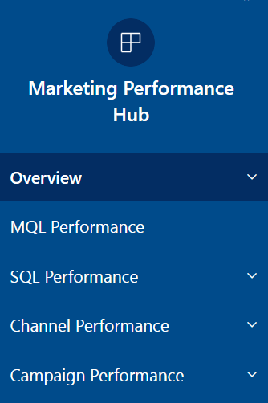
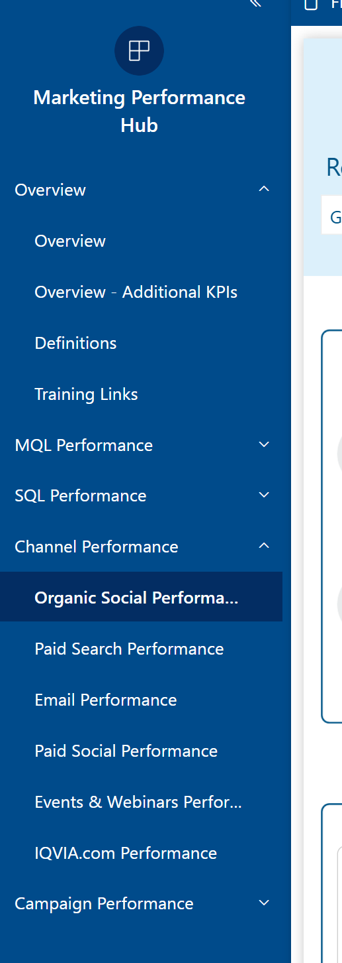
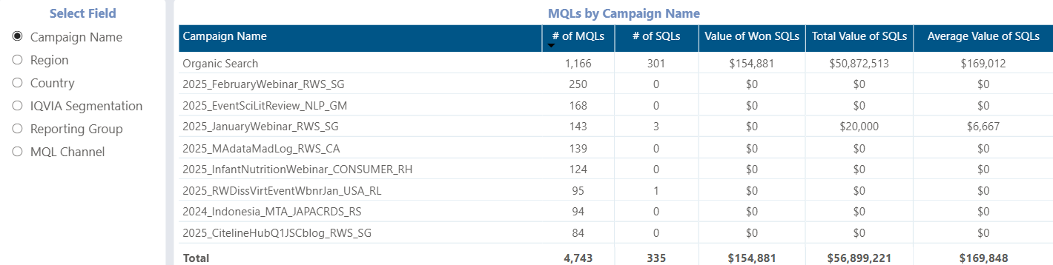
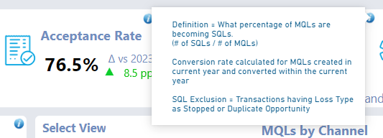
General Tips
Use column headings to sort
Some visuals have a field selection option. Use this to transform the first column of the table and see the metrics adjust.
Easily navigate through the dashboard with the navigation bar. Make sure to expand the Overview, SQL, Channel and Campaign Dashboard to see all subpages
Tool Tips
Hover over the i symbol to see definitions and formulas

Slide 7
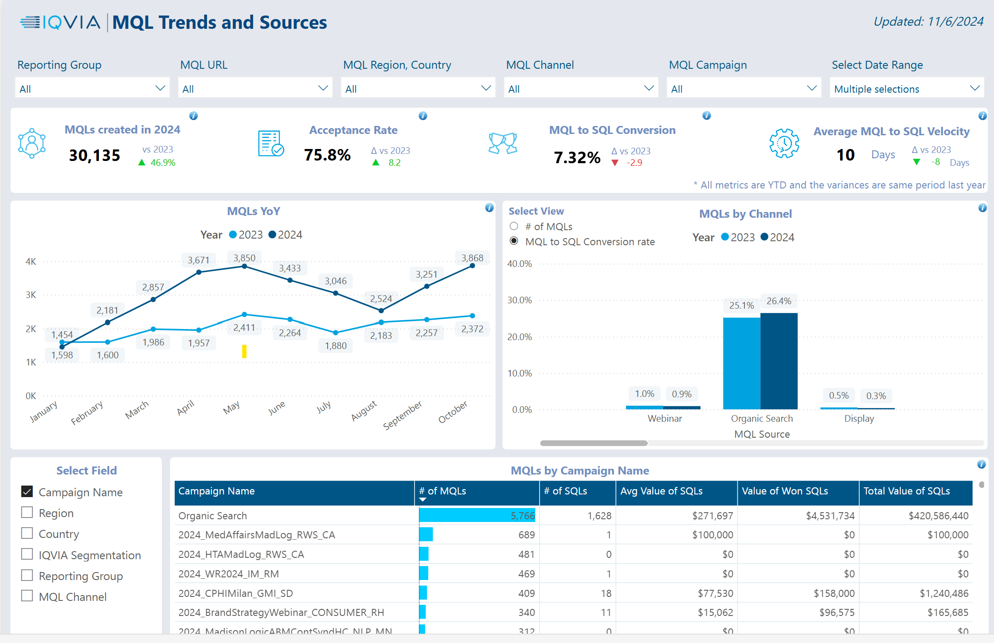
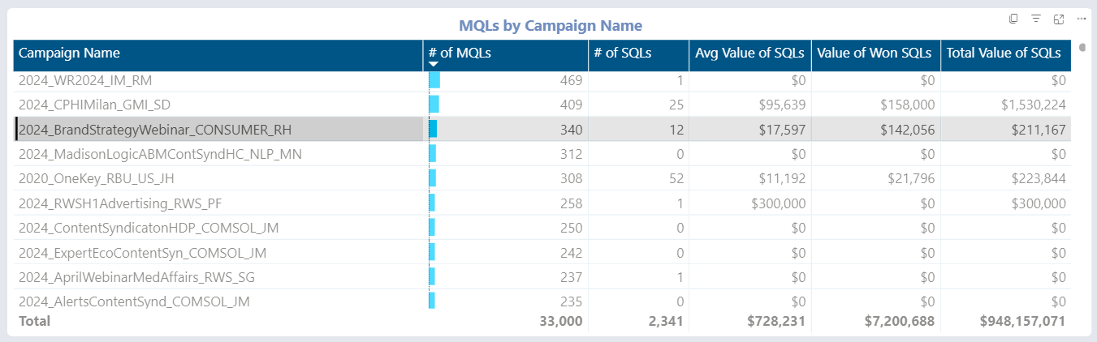
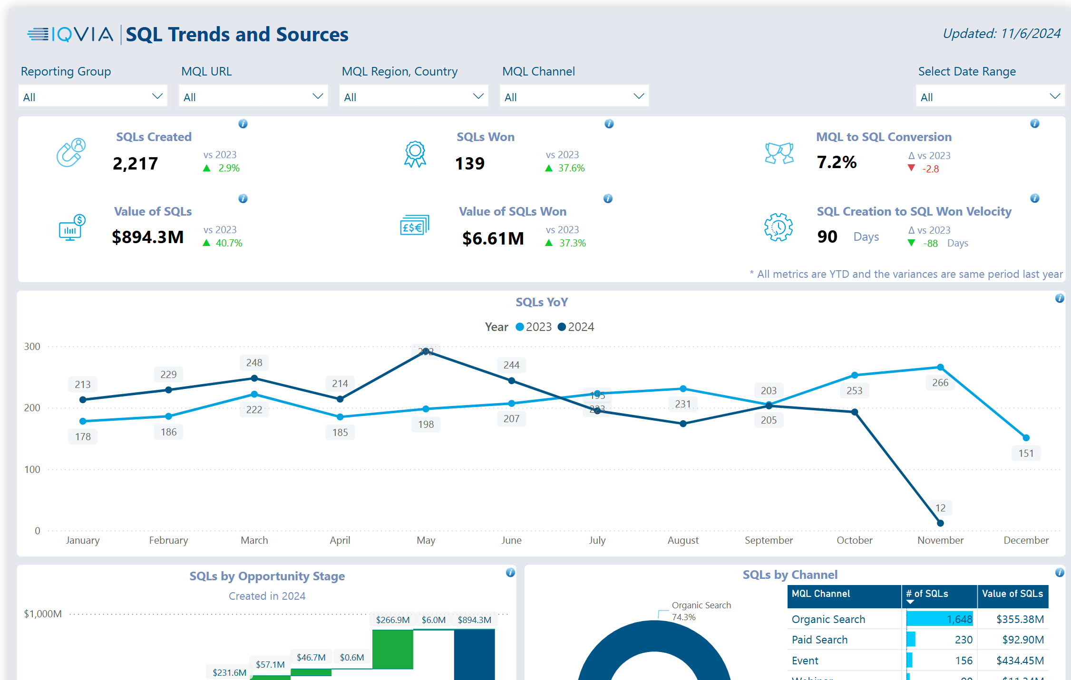
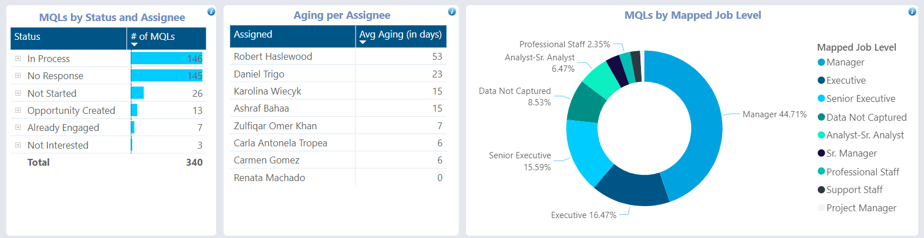
General Tips Continued
Example of Data Selection
Selected 2024_BrandStrategyWebinar_Consumer_RH
Visuals are interactive. Select a data point within the visuals and see how the rest of the page transforms to all relevant information based on the selection.
Below visuals are updated based on the campaign name being selected.
See the number of MQLs for confirmation.

Slide 8
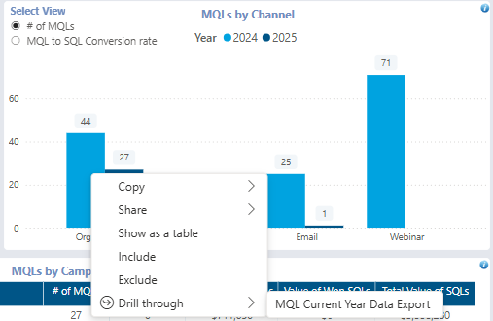
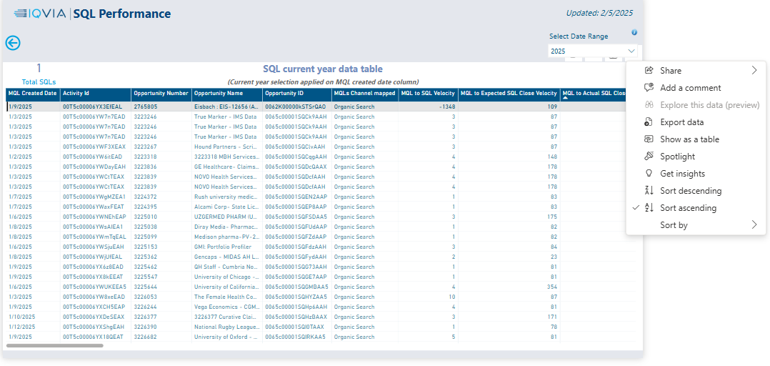
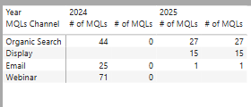
General Tips Continued
Each data item can be right clicked to drill through the data further to see a detailed view which can then be sorted by column, focused on, or exported into excel. Additionally, items can be showed as a table

Slide 9
Self-service user training
Microsoft:
View a report - Power BI | Microsoft Learn
What can I do with the Power BI service as a consumer? - Training | Microsoft Learn
LinkedIn Learning:
Power BI Essential Training | LinkedIn Learning
Enhancement and fixes/Questions and issues​
Centralized intake form

Slide 10
Q&A

Slide 11
Reporting Champions
Lee Schwartz
RDS | Avacare | Biotech
| Clinical Medtech | SRC
Alberto
Catelani
EMEA
Joelle Dyke
DPO | CS
Clint Allen
RWS
Ken Kasee
US RBU
Alexis Mills
CS
Robert
Haslewood
Consumer Health | MedTech
Institute
Lab
JAPAC RDS
ADSC
NLP
LSG
PCS
Privacy Analytics
HSS
EPG Health
PPA
IQVIA Digital
Canada
Other groups to consider as we evolve:
APAC
LATAM
Japan
Enterprise
Carrie Feltkamp
DMO
Kristen
Powell
Marketing Operations
Srujana Pavuluri
Marketing Operations
Notes:
Other UAT Participants:
Joy Thomas
Erica McCready
Todd Culpepper
Chiranjeevi Gattam
Eduard Torok
Ken Kasee
Hannah Devereaux
Brian Burns
Natalie Culwell
Edie Eichert
Shivasagar Biradar
Sandeep Kamboj
Carolina Sampedro
Hemant Galagali
Brandon Haslip
Danielle Schmidt

